Slide 1
MINI ANNUAL
Mini Annual Report 2019

Slide 2
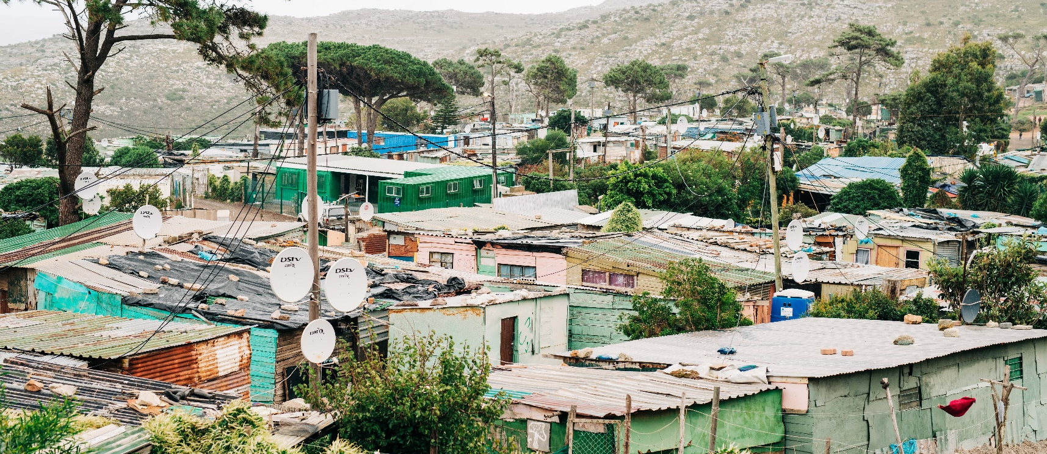
Vision & Mission
Our Vision:
We seek to reach people for Christ, Bringing Hope and Breaking the Despair of poverty and disease
Our Mission:
To spread the good news of Jesus Christ in a life changing way and to encourage people to follow Him.
To play a vital role in the prevention, care, treatment and support of people infected and affected by HIV and AIDS and other chronic illnesses.
To undertake community development, inter alia through education, social and health related programmes.

Slide 3
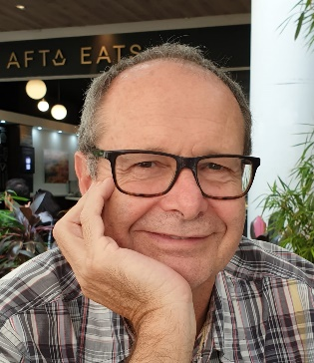
Chairman’s Report
When I reflect back on another year in the life of Living Hope, I am amazed by what has been achieved by our wonderful staff. There have been many challenges but when one sees what has been accomplished this year, then all that one can say is, ‘What a wonderful God who has blessed Living Hope in fantastic ways and to Him be all the glory’. It is clear that nothing is impossible with the Lord. During this past year we have served an incredible 111,798 people. On an average that means each staff member has served 559 individuals this year. What a privilege it is to serve people by Bringing Hope and Breaking Despair. We have a staggering 43 programmes which cover a wide range of diversity. All of this was managed on an expenditure of R27,9 m. Our income, due to the generosity of wonderful donors was greater than our expenditure.
My thanks to the Trustees, Staff, Volunteers, Donors and Supporters of Living Hope – what a wonderful
team. Most of all my thanks to the Lord, who has made all this possible.
John V Thomas: Chairperson: Living Hope Trust
Programme Director’s Report
It has been yet another God-filled year of surprises and achievements as we have worked together in Bringing Hope and Breaking Despair through the different Living Hope programmes. The implementation of our operational plan against our strategic plan has been exciting to see and we are grateful to the Lord to see many of these plans well on their way to fulfilment. Our 43 programmes are facilitated by our 7 programme departments of Spiritual, Health Care Centre, Integrated Home and Community Based Services, HAST, (HIV, AIDS, Sexually Transmitted Infections & Tuberculosis), Substance Abuse Recovery, Life Skills and Farming across 6 under resourced areas.
I am grateful to the Lord for His provision, goodness and faithfulness to us as an organisation and to all who
have served, donated, prayed and encouraged us along the way – thank-you!
Avril Thomas: Programme Director

Slide 4
We wish to acknowledge that all our programmes are made possible through the generous support of:
Don Reid Hein & Froula Van Zyl Bill & Diane Waud William & Lisa Rollins David Porteous The Mason Family Mike Winfield
Wiegand Morning Star Foundation Patrick & Melanie Hammer Bronner Burgess Memorial Fund Jon & Denise Beckman
Acknowledgements
And all of our other sponsors who contribute into our programmes.
The Board of Trustees, Management and Staff of Living Hope wish to thank everyone for their contribution. Please note that the content of our programmes is the responsibility of Living Hope and do not necessarily reflect the views of our donors.

Slide 5
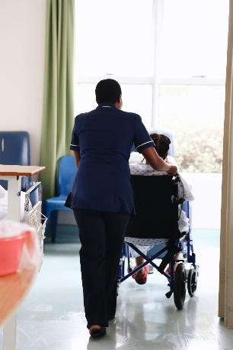
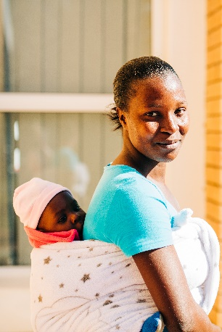
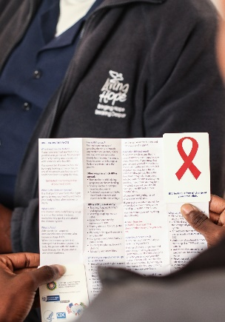
Compassionate Health Care
This past year has been a year of changes in the Health Care Centre. It is a privilege to Bring Hope and Break the Despair of poverty and disease through the provision of excellent healthcare in the hospital setting delivered by committed, competent and compassionate staff, at no cost to clients. This is all made possibly through funding from the Department of Health and Compassus USA, as well as many other generous donors. During this past year we have gone through an extensive re-accreditation programme with the Council of Health and Science of South Africa. Thanks so much to our donors and staff for enabling us to continue to bring hope to 229 patients needing healthcare!
Fredelene Smith: Health Care Centre Manager
Health Care Centre Report
Our core focus is to assist our clients to cope at home with their disease, lifestyle issues and behaviour patterns, and to educate them on well-being and the prevention of illnesses. Our Community Based interventions treated 901 clients and provided a meaningful service to the community by caring for the sick. Through the First 1000 days programme (the period from conception, through to 2 years of age) we assisted mothers with education and support using 3 different age appropriate curricula. We have had a total of 123 graduates. Through clinic talks, we reached 3987 clients. The Support Group ministry is actively involved in the distribution of chronic medication to 524 clients referred by local clinics and False Bay Hospital. Our staff have also delivered HIV and TB treatment adherence support as well as prevention and promotion service to clients. Our goal is to integrate all our services and to connect with each client holistically.
Joy Truter: Integrated Home and Community Based Services Programme Manager
Our Health Counsellors serve a vital role in clinics and hospitals as they break the sensitive and confidential results of those testing for HIV, TB and STIs and invariably become that listening ear for all those desperate to share their burdens. Most of our Counsellors have been with Living Hope for over ten years, some from our early years and they have developed a reputation of trust and confidentiality with all with whom they work. The Counsellors are well-equipped and are often asked to speak in schools, hospitals and other community settings. Their expertise covers all aspects of Family Planning, Adherence to Medication, Chronic Disease Lifestyles as well as issues pertaining to Substance Abuse and recognising symptoms of Cancer. The total number of people served by the HAST programme in 2019 was 57 819 people.
Sue Schoultz: HAST Co-ordinator

Slide 6
Stats at a glance
901 Clients treated by Community Based interventions |  | 229 Patients cared for in the Health Care Centre
57 819 Clients reached in our HAST programme |  | 123 Graduates of the First 1000 days programme
524 Patients who’ve received their Chronic Medication through our Support groups |  | 3 987 Clients reached through clinic talks

Slide 7
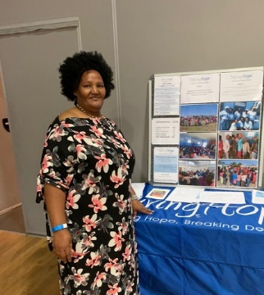
Eastern Cape
On 1 March 2019 Living Hope became the proud owners of Klako Glen Farm bordering Mzamahle to the Eastern Cape. During this past year the Life Skills programme has touched 421 children and 192 teens. Health talks presented at the local Mzamomhle and Gonubie clinics have reached 12 222 clients. 337 Defaulters were recalled to the clinic to continue their treatment. The First 1000 Days programme has continued to flourish and 17 moms and babies have attended these weekly sessions. 20 people have attended the Chronic Disease
Support Groups and 17 HIV+ clients completed the I ACT course.
We are indebted to the Chets Creek Church, Jacksonville, who are the primary generous donors and founders, together
with Gonubie Baptist Church, of this ministry. We are also thankful to “One More Child” for their continued support for
helping us feed the children and teens in our Life Skills programme as well as our 1st 1000 Days programme.
Chantel Delcarme: Community Networking Co-Ordinator
Stats at a glance
13 209 People reached in the Eastern Cape |  | 421 Children reached in the Eastern Cape
192 Teens reached in the Eastern Cape |  | 337 Defaulters recalled to the clinic to continue their treatment

Slide 8
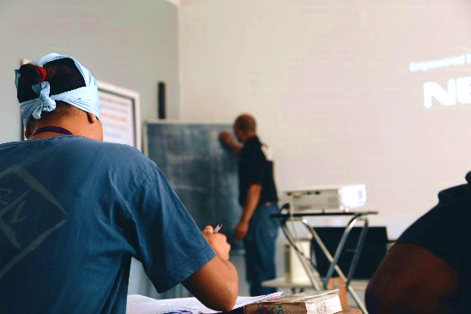
Recovery Programme
It has been most gratifying to see the integrated ministry as other Living Hope programmes get more involved with the Recovery programme supplying much needed skills and expertise in the areas of HIV testing and screening, TB information and testing, and parenting classes. It was discerned this year that clients were not as literate and presented with lower scholastic achievement. This has meant that an adaption to the presentation of the lectures has had to take place accompanied by a slower pace to assist those with low literacy levels.
The Recovery Programme has been kept busy with many requests for information and training regarding Substance Abuse and Recovery from a wide variety of organisations, like churches, trade unions, commerce and industry as well as the radio media.
We thank God for enabling us to serve 6 663 people and for His gracious prompting and provision and look
forward to another year of faith in action.
Peter Lovick: Recovery Programme Manager
Stats at a glance
6 663
People reached through the Substance Abuse Recovery Progammes

Slide 9
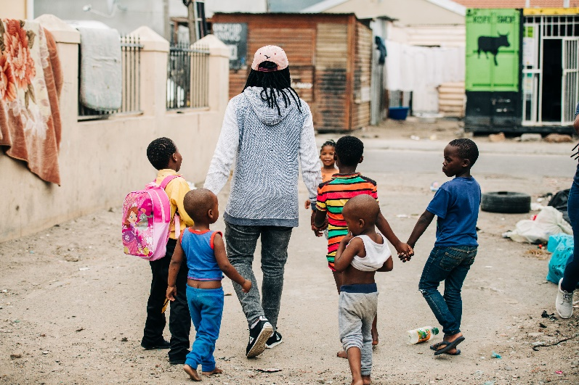
Life Skills Programme
This year our Life Skills department has focused on being more restorative in our ways of disciplining and handling children, looking rather to restore Biblical values Life Skills that will change the child’s thinking and behaviour.
We are grateful for successful applications to the Department of Community Safety for partial funding for a week of Holiday Clubs in June/July and another in the December school holidays. Living Hope has been a partner since 2015 and has contributed to the Department of Community Safety reaching in excess of 20 000 children and youth.
Through working in Pre-schools and Primary schools, Afternoon and Holiday Clubs for
children and teens, providing Parenting talks and Workshops, Family Strengthening
programmes, Way to Work and Job Centre the Life Skills team has served 8 999 people.
We are so thankful to all our DAD donors and funders who have given so generously
and contribute to the continuation of the Living Hope’s vision and mission for Life Skills.
Without God’s blessing and providence we cannot do what He has purposed us to do.
Nathan Panti: Life Skills Programme Manager
Stats at a glance
8 999 People were reached through the various programmes

Slide 10
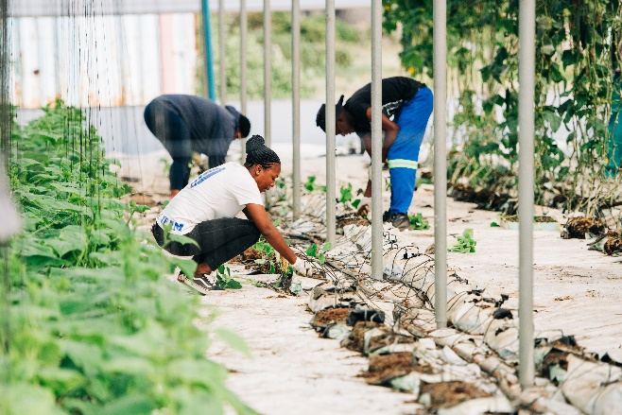
Harvest Training Initiative
The Harvest Training Initiative is an Agricultural training programme which seeks to prepare farmers to be fully equipped as Farm Managers and Farming Entrepreneurs.
Four students completed phase 3 in December 2018 and presented their business plans. The winner, Fezeka Mndayi, is managing a single span hydroponic tunnel growing tomatoes and cucumbers. She is managing very well and is able to pay off her loan.
As part of their mission school graduation requirements, 8 students went on a 4 day mission trip to Koringberg in March 2019. They ministered to 339 people by running kids clubs, ministering to the elderly, vaccinating 160 livestock and showing the Jesus film. 59 people prayed to accept Christ. 19 students have finished an Alpha course and attended Live School four
times a week.
During this reporting year the HTI programme has served 294 people.
Gerrit Kleynhans: Harvest Training Initiative Programme Manager
Stats at a glance
294
People reached through the Programme
19
Students completed an Alpha course

Slide 11
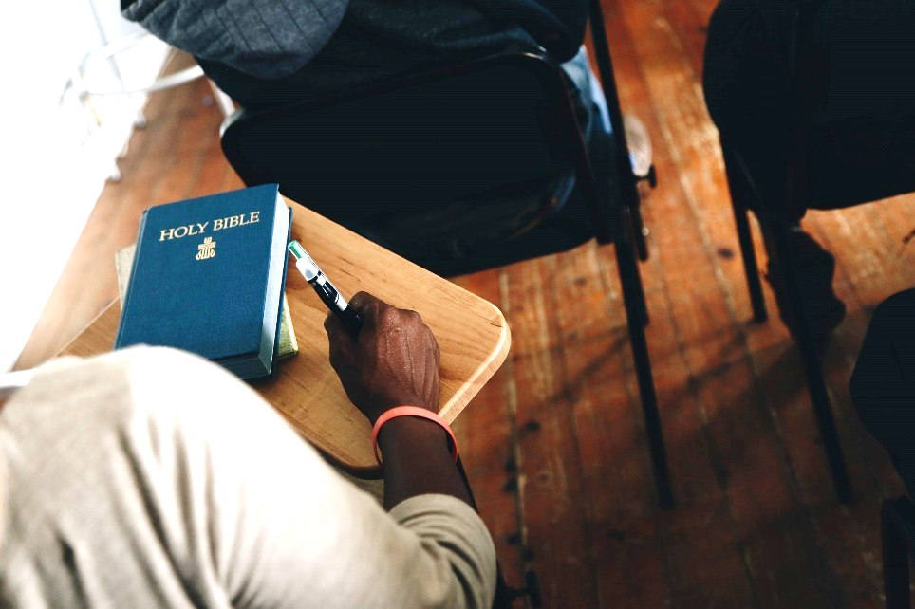
Chaplaincy
Praise the Lord, all you nations; extol Him all you peoples. For his love toward us and the faithfulness of the Lord endures forever. Praise the Lord. Psalm117
During the past year, 47 of our staff were trained on how to practically share their faith. We praise the Lord that during the training some recommitted themselves to Christ while others managed to reach people for Christ during the practical session. It has been encouraging to see some continue to evangelise in their daily work using what they have learnt.
We had three corporate prayer days with the staff during the year and we
have weekly prayer meetings on a Wednesday at Capri. We thank God for
our prayerful staff that continue to trust the Lord who is always with us.
It is a privilege to minister to the patients in the Health Care Centre on a daily
basis to the 229 patients we had and to share the life-changing Gospel of
Jesus Christ. Each one receives a comforting Scripture verse and is prayed for
every day. Twice per month a Bereavement support group is facilitated for
The Health Care Centre staff.
I praise God for the daily opportunities we have to serve our Saviour and to
see the hope and difference that He makes to so many.
Noloyiso Mzizana: Chaplain
Stats at a glance
47
Staff members were trained on how to practically share their faith
229
Patients ministered to in the Health Care Centre

Slide 12
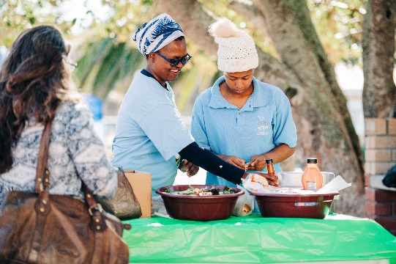
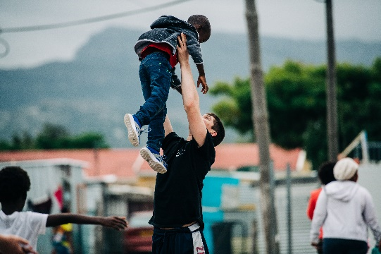
Teams and Volunteers
This year Living Hope hosted 207 people who came to serve the Lord on a short term mission at Living
Hope. Teams generally serve for a period of 7 to 10 days and come alongside our staff as they serve the
communities through the various programmes that we offer. Our greatest need for assistance is with
Holiday Clubs that run 8 weeks per year in 5 different communities and the teams add value by providing
material resources, help on the ground and encouragement to staff while pouring blessing into the lives of
the children in these communities.
I am always humbled and blessed to see how from planning a team’s itinerary to its execution God’s hand is evident in the work we do with the teams and also the impact it makes, both on the lives of the team members as well as those who are served.
Karen Peiser: Teams Manager
In the last year, 237 local and international volunteers have given freely of themselves in many of our Living
Hope programmes. One notable point of our volunteer demographic is the amazing cultural blend of South
Africans and foreign nationals that choose to serve with us. Over the past 4 years, we have seen an
incredible increase in our local volunteer work force. We have seen a 641% increase over the past four years
going from 29 local volunteers in 2015/16 to 215 local volunteers in 2018/19 of which 22 were International
Volunteers.
Kenny Kneezle: Volunteer HR Co-ordinator
Stats at a glance
207
People served the Lord on a short term mission
237
Local and International volunteers
641%
Increase of volunteers from 2015 to 2019

Slide 13
Human Resources
The Living Hope Human Resources department consists of 2 full time employees and 1 full time volunteer. Our volunteer co-ordinates and oversees both local and international volunteers.
For our reporting period (01 April 2018 – 31 March 2019) we employed a total of 208 staff members. 175 staff members are employed within the Health Sector (Community Based Services, Health Care Centre, HAST and Addiction Counsellors) and Education programmes (Life Skills Educators). This includes professionally qualified staff such as our Doctor, Nurses and Social Workers. Our Harvest training Initiative (farming) programme employs 6 permanent staff members. Support services (Finance, HR, Procurement, M&E, Marketing, Reception, Administrators and Maintenance) employs 19 staff. Senior Management (Executive Director, Programmes Director, Finance Manager & Programme Managers) employs 8 staff members.
Kerry-ann Ives: Human Resources Manager
Monitoring and Evaluation
“We believe therefore we act”
It is wonderful to see the fruit of what we do as we serve. Everyone in Living Hope has served so sacrificially.
We have seen a 1.5% increase of individual people served in 2018. During this year we served 111 798 compared to 2017 when we served 110 151 and a 13% increase over 2016 when we served 97 809. The increase in number of individual people served this year is less than last year because we decided to be extremely prudent in our reporting by only reporting 55% of those present in the large groups we run.
Our Quality Improvement tracks 30 Quality goals which are constantly re-evaluated to improve how we do what we do. The Quality Improvement programme received a 100 percent evaluation during a recent external accreditation review done by the Council for Health Service Accreditation of Southern Africa.
Tawanda Mutsigwa: Monitoring and Evaluation Manager

Slide 14
Finance Report
In the 2018-2019 budget year Living Hope received R29 649 344 in income and expended R27 973 677 on our programmes. The income funding increased by 31% mostly due to the huge amount of donation support received for the expansion and capital growth projects. After deducting allocated funds, we had an operational deficit of R168 428.
This year 16c in every Rand or Dollar of funding went to cover administration costs, which means that 84c in every Rand or Dollar was directed back into our various ministry programmes and projects to impact the communities (For a more detailed Financial Report see Audited Financial Statements 2019)
Jessica Bennett: Finance Manager
Stats at a glance
16c In every Rand/Dollar funded goes to cover administration costs R29 649 344 Income for 2017/2018 |  | 84c In every Rand/Dollar raised goes directly into our various programmes R27 973 667 Expenses & Capital Projects for 2017/2018

Slide 15
Contact Living Hope
Facebook
LivingHopeSouthAfrica
Twitter
LivingHopeZA
Website
www.livinghope.co.za
Email
office@livinghope.co.za
USA
PO Box 1140
Grayson, GA 30017-1140
Tel: +1 770 879 8411
United Kingdom
33 Cecil Rd, Hertford
SG13 8HR
Tel: +44 7759 933558
South Africa
7 Kommetjie Road,
Opposite Food Zone, Capri
021 784 2800
PO Box 1700
Sun Valley, South Africa
7985

